Slide 1
BITS ZG553: Real Time Systems [L-3a: Clock-driven Scheduler Examples]
K G Krishna
WILP Division, BITS-Pilani, Hyderabad

Slide 2

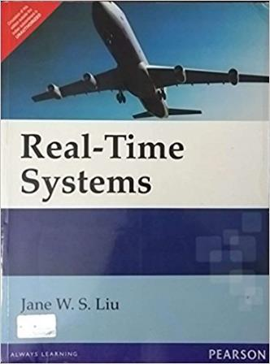
Text Book / References
Reference (R1)
Text Book (T1)
Note: As the above two books focus on theoretical treatment of the subject, Students are strongly advised to refer to web sources / MOOCs videos / library within their own organizations for more practical understanding of the topics.

Slide 3
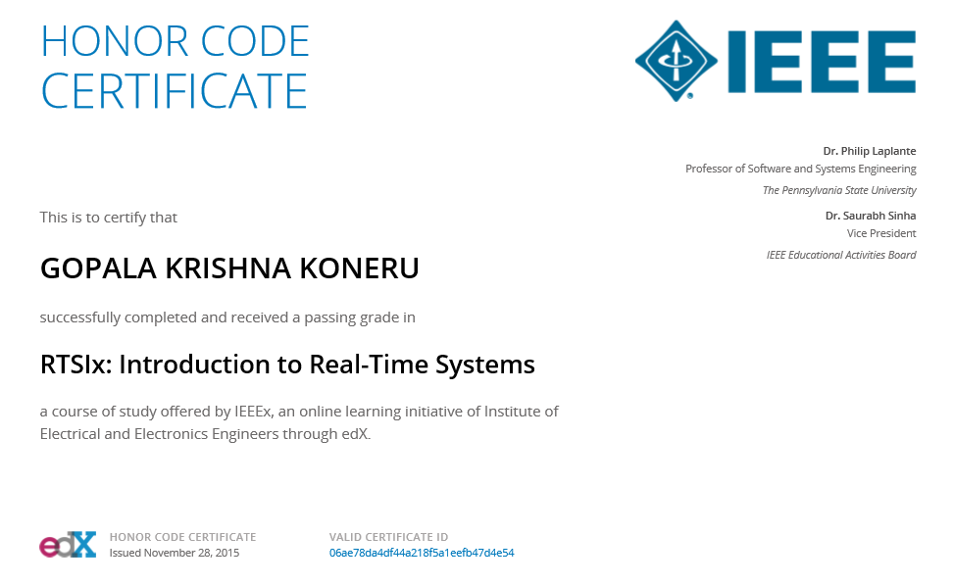
Excellent MOOCs Videos
(Coursera, edX,…)

Slide 4

RTS Primer – For Light Reading

Slide 5
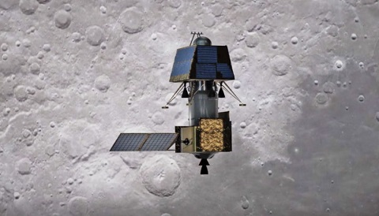
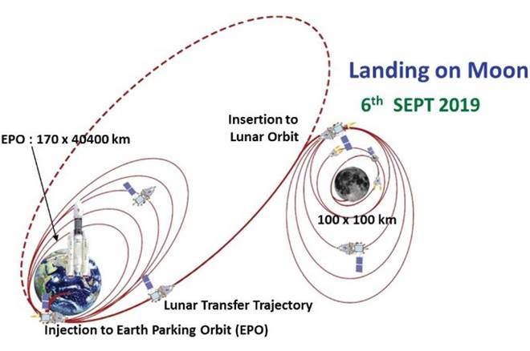
What Really Happened?
Lessons from ‘Unknown-Unknowns’!

Slide 6
L-3a: Introduction to Scheduling -
Clock-driven Scheduler, Examples
Ref: [T1]
Note: Students are requested to NOT to rely on PPTs/Recorded sessions as their only source of knowledge, explore sources within your own organization or web for any specific topic; attend classes regularly and involve in discussions;
PLEASE DO NOT PRINT PPTs, Save the Environment!
Source PPT Courtesy: Some of the contents of this PPT is sourced from Presentations by Prof B Mishra / Prof K R Anupa, BITS-Pilani WILP Faculty

Slide 7
Assumptions
There are ‘n’ periodic tasks in the system and ‘n’ is fixed
The parameters of all periodic tasks are known a priori.
Variation in the inter-release time is negligibly small. For all practical purpose each job in T_{i} is released p_{i} units of time after the previous job in T_{i} .
Each job J_{i,k} is ready for execution at release time r_{i,k}
A periodic task T_{i} is characterised by the 4-tuple (Φ_{i}, p_{i} , e_{i} , D_{i} ).
Example: (1, 10, 3, 6) periodic task
1st job is released at time 1. It must completes by time 7 (=1 + 6). It executes for 3 units of time.
2nd job is released at time 11 (= 1+ 10). It must complete by time 17 (=11 + 6). It executes for 3 units of time.
....
Tuples having default values are omitted.
By default, the phase of each task is 0 and relative deadline is equal to the period.
Example: (10, 3, 6) and (10, 3) have zero phases and relative deadlines of 6 and 10 respectively.

Slide 8
Example
Consider 4 tasks: T1 = (4,1);T2 = (5, 2); T3 = (20, 1); T4 = (20, 1)
Hyperperiod = LCM (4, 5, 20, 20) = 20 -> Schedules can repeat every 20 time units
Max no of jobs in each hyperperiod (No of entries in the schedule) = (20 / 4) + (20 / 5) + (20 /20) + (20 /20) = 5 + 4 + 1 + 1 = 11
T1 |  |  |  | T1 |  |  |  | T1 |  |  |  | T1 |  |  |  | T1 |  |  |  | T1
T2 | T2 |  |  |  | T2 | T2 |  |  |  | T2 | T2 |  |  |  | T2 | T2 |  |  |  | T2
T3 |  |  |  |  |  |  |  |  |  |  |  |  |  |  |  |  |  |  |  | T3
T4 |  |  |  |  |  |  |  |  |  |  |  |  |  |  |  |  |  |  |  | T4
1 | 2 | 3 | 4 | 5 | 6 | 7 | 8 | 9 | 10 | 11 | 12 | 13 | 14 | 15 | 16 | 17 | 18 | 19 | 20 | 21
T1 | T3 | T2 | T2 | T1 | T2 | T2 | T4 | T1 |  | T2 | T2 | T1 |  |  |  | T1 | T2 | T2 |  | T1
1 | 2 | 3 | 4 | 5 | 6 | 7 | 8 | 9 | 10 | 11 | 12 | 13 | 14 | 15 | 16 | 17 | 18 | 19 | 20 | 21
(An arbitrary static schedule)

Slide 9
A Clock-Driven Scheduler
Whenever the parameters of the jobs are known a priori (As in case of Hard Real-time Systems), it is better to construct a static schedule offline.
We call a periodic static schedule a cyclic schedule as well.
Store the pre-computed schedule in a table
Each entry (t_{k}, T(t_{k})) in the table gives a time t_{k}, and the task T_{k} or I to be scheduled at that time.
T_{k} is a periodic job and I is idle interval.
There should be a timer, which expires at the decision times t_{k} and raises an interrupt as it expires.
This interrupt wakes up the scheduler, which schedules the appropriate job from the off-line schedule.
If the job to be scheduled is I, then it is the idle time (no periodic job is available to be scheduled). Hence the job at the head of the aperiodic queue is scheduled.

Slide 10
General Structure of Cyclic Schedules
A cyclic scheduler repeats a pre-computed schedule.
The pre-computed schedule needs to be stored only for one major cycle.
Usually the major cycle is the Hyperperiod.
Each task in the task set to be scheduled repeats identically in every major cycle.
The major cycle is divided into one or more frames
The scheduling points of a cyclic scheduler occur at frame boundaries. This means that a task can start executing only at the beginning of a frame.
The frame boundaries are defined through the interrupts generated by a periodic timer. Each task is assigned to run in one or more frames.
Tasks | Frame
T₁ | f₁
T₃ | f₂
T₅ | f₃
T₄ | f₄
I | f₅

Slide 11
A Clock-Driven Scheduler
H = Length of the hyperperiod
N = Number of entries in the schedule of each hyperperiod
I = Idle Interval
Input: Stored schedule (t_{k}, T(t_{k})), for k = 0, 1, …, N-1
-------------------------------------------------------------------------------------------------------------------------
Task: SCHEDULER:
set the next decision point i and table entry k to 0;
set the timer to expire at t_{k}
do {
accept the timer interrupt;
if(an aperiodic job is executing) preempt it;
current task T = T(t_{k})
i = i++;
compute the next table entry k = i mod(N)
set the timer to expire at └i/N┘ H + t_{k}
if(the current task T == I)
schedule the job at the head of the aperiodic queue
else
schedule the task T
}
End SCHEDULER

Slide 12
General Structure of Cyclic Schedules
Frames
Scheduling time is divided into multiple frames of size ‘f’.
Scheduling is done at starting of each frame, not at any other time.
Hence there is no preemption within a frame.
The phase of each periodic task is a nonnegative integer multiple of a frame. In other words, the first job of every task is released at the beginning of some frame.
Apart from scheduling decision, schedule carries out monitoring and enforcement actions at the beginning of each frame.

Slide 13
Floor and Ceiling Functions
Floor
floor(x) = is the largest integer not greater than x
Ceiling
ceiling(x) = is the smallest integer not less than x
Example:
x
2.4 | 2 | 3
5.5 | 5 | 6
-2.1 | -3 | -2
-2 | -2 | -2

Slide 14
Size of a Frame
A selected frame size should satisfy the following three constraints.
Minimum Context Switching
To avoid unnecessary context switches, the selected frame size should be larger than the execution time of each task, so that when a task starts at a frame boundary it should be able to complete within the same frame.
It means, the frame size should be larger than maximum execution time.
Minimization of Table Size
This constraint requires that the number of entries in the schedule table should be minimum
Unless a frame divides the major cycle, the number of entries in a major cycle will not be sufficient for the schedule.
Hence the frame should divide the major cycle i.e. Hyper period of the tasks.

Slide 15
Size of a Frame
Task
arrived
Deadline
Task will be scheduled at this time instant
kF
(k+1)F
(k+2)F
(k+3)F
Satisfaction of Task Deadline
At least one frame should be there between the time job is released and its deadline.
Otherwise it will miss the deadline, just because it gets scheduled late in the next frame boundary (as shown in the diagram)
These three conditions are formulated into three equations in the next slides.

Slide 16
Frame Size Constraints
Minimum Context Switching
Frame size should be larger than maximum execution time, i.e.
... (1)
Minimization of Table Size
Length of a major cycle is equal to the Hyperperiod H.
The frame size should be as short as possible so that there are integer number of frames in an Hyperperiod H. For this it needs to divide the Hyperperiod, which in turn implies that it should divide the period p_{i} of at least one task T_{i}. i.e.
... (2)
Let F = No of frames in an Hyperperiod (should be an integer, as per the previous equation)
The Hyperperiod, which begins at the beginning of (kF + 1)st frame, is called a ‘major cycle’, for k = 0, 1, …
Satisfaction of Task Deadline
Hence frame size should be small enough so that between the release time and deadline of a job, there should be at least one frame.

Slide 17
Frame Size Constraints
frame k
frame k+1
frame k+2
t
t’
t+f
t+2f
t’+ D_{i}
t’+ p_{i}
t+3f
t = Beginning of the frame in which a job in T_{i} is released
t’ = Release time of the job
If(t’ > t), we need frame k+1 to be in t’ and t’+D_{i}.
For this to happen,
t + 2f ≤ t’+D_{i}
=> 2f – (t’-t) ≤ D_{i}
t’ is an integer multiple of period p_{i} (say lp_{i}) and t is an integer multiple of frame f (say kf).
So, t’ - t= lp_{i} -kf, where k, l are positive integers.
kf – lp_{i} will be at least be equal to GCD of f and p_{i}.
Hence t’ –t ≥ gcd(f, p_{i})
Then the above inequality becomes
2f – gcd(f, p_{i})≤ D_{i} ...(3)

Slide 18
Frame Size Constraints
For t = t’, we need f ≤ D_{i} for a frame to be included between t’ and D_{i}
If eq. (3) is satisfied, then above condition will automatically be satisfied, since gcd(f, p_{i}) < f.
So eq. (3) is sufficient for both the conditions t = t’ and t < t’.
Equations (1), (2) and (3) are referred as ‘frame size constraints’.

Slide 19
Multiple frame sizes satisfying the Frame size constraints
For a given task set it is possible that more than one frame size satisfies all the three constraints.
In such cases, it is better to choose the shortest frame size.
This is because of the fact that the schedulability of a task set increases as more frames become available over a major cycle.

Slide 20
Frame Size Constraints - Example
Exercise 5.1 (a)
Find out an appropriate frame size for the following system of periodic tasks to be scheduled executed according to a cyclic schedule.
{(6,1), (10,2) and (18,2)}.
Solution:
Max execution time = 2.
So frame size f ≥ 2 ... (1)
Frame size should divide at least one period.
So, f = 2,3,5,6,10,18 ... (2)
2f – gcd(f, p_{i})≤ Di
So for T1, 2f – gcd(f, 6) ≤ 6
f = 1, 2, 3, 4, 6
For T2, 2f – gcd(f, 10) ≤ 10
f = 1, 2, 3, 4, 5, 6, 10
For T3, 2f – gcd(f, 18) ≤ 18
f = 1, 2, 3, 4, 5, 6, 7, 8, 9, 10, 12
Hence values of f, which will satisfy 2f – gcd(f, p_{i})≤ Di
f = 1,2,3,4,6 ... (3)
The values of ‘f’, which will satisfy eq (1), (2) and (3) are: f = 2,3,6
Hence, possible values for frame size are 2, 3 and 6.
So choose 2 (since it is smallest) as the frame size.
Tasks | Period / Deadline p_{i} / D_{i} | Execution time e_{i}
T1 | 6 | 1
T2 | 10 | 2
T3 | 18 | 2

Slide 21
Job Slices
Example
Find out an appropriate frame size for the following system of periodic tasks to be scheduled executed according to a cyclic schedule.
{(4,1), (5,2,7) and (20,5)}
Solution:
Max execution time = 5.
So frame size f ≥ 5 ... (1)
Frame size should divide at least one period.
So, f = 1,2,4,5,10,20 ... (2)
2f – gcd(f, p_{i})≤ Di
So for T1, 2f – gcd(f, 4) ≤ 4
f = 1, 2, 4
For T2, 2f – gcd(f, 5) ≤ 7
f = 1, 2, 3, 4, 5
For T3, 2f – gcd(f, 20) ≤ 20
f = 1, 2, 3, 4, 5, 6, 7, 8, 9, 10, 20
Hence values of f, which will satisfy 2f – gcd(f, p_{i})≤ Di
f = 1,2,4 ... (3)
Satisfying eq (1) and (3) is not possible.
Tasks | Period p_{i} | Deadline D_{i} | Execution time e_{i}
T1 | 4 | 4 | 1
T2 | 5 | 7 | 2
T3 | 20 | 20 | 5
So it is better, if we can slice the job with larger execution time T3 to 3 subtasks (a job of computation can be broken into multiple procedures, a message transmission job can be broken into sending multiple smaller messages etc) so that all frame size constraints gets satisfied.
In this case, if we slice T3 as, T3 = {(20,1), (20, 3), (20, 1)} , then eq (1) will become f ≥ 3. So frame size constrains will be satisfied e.g. f = 4.
This process is called job slicing.

Slide 22
Process of Constructing Cyclic Schedules
Tasks | Period p_{i} | Deadline D_{i} | Execution time e_{i}
T1 | 4 | 4 | 1
T2 | 5 | 7 | 2
T3.1 | 20 | 20 | 1
T3.2 | 20 | 20 | 3
T3.3 | 20 | 20 | 1
Process
Choosing frame size
Partitioning the jobs into slices
Placing the slices in the frames
For the previous example, we have
Partitioned T3 into 3 job slices.
Fixed the frame size f = 4
Now we have to create the schedules by putting the jobs and job slices into fames.
T₁
T₂
T_{3.1}
T₁
T_{3.2}
T₁
T₂
T₁
T₂
T_{3.3}
0
4
8
12
16
Frame 1
Frame 2
Frame 3
Frame 4

Slide 23
Cyclic Executive
“Cyclic Executive” refers to a scheduler that deterministically interleaves and sequentializes the execution of periodic tasks on a CPU according to a given cyclic schedule.
Each job slice is a ‘procedure’
A cyclic executive executes in a single do loop, beginning of each frame and executes the slices scheduled within a frame.
The stored table that gives the precomputed cyclic schedule has F entries, where F is the number of frames per major cycle (please note that the schedule will repeat in every major cycle, hence storing the schedule for one major cycle is enough)
Each entry is called a ‘scheduling block’. A scheduling block for kth frame is denoted by L(k) and it stores the job slices to be scheduled in kth frame.
Usually a ‘periodic task server’ executes the job slices of a frame.
Upon completion of executing the periodic job slices scheduled in the current frame, if there is time remaining in the current frame, the cyclic executive schedules aperiodic jobs.

Slide 24
Cyclic Executive
F = Number of frames in a major cycle
L(k) = Names of the job slices that are scheduled to be executed in frame k, called ‘scheduling block’
-------------------------------------------------------------------------------------------------------------------------
Input: Stored schedule: L(k), k = 0, 1, …, F-1
Aperiodic job queue
Task: SCHEDULER:
current time t = 0;
current frame k = 0;
do {
accept the timer interrupt at time t_{f};
current block = L(k);
t = t + 1;
k = t mod(F);
if last job is not completed take appropriate action;
if any of the job slices are not released, take appropriate action;
execute the slices in the current block by waking of the periodic task server;
sleep until the periodic task server completes;
while (aperiodic job queue is not empty) {
wake up the job at the head of the aperiodic job queue and schedule it;
sleep until the aperiodic job completes;
remove the aperiodic job from the queue;
}
sleep until next timer interrupt arrives;
}
End SCHEDULER

Slide 25
Scheduling Aperiodic Jobs
Response time of aperiodic jobs is an important criterion
Sooner the aperidic job completes, the more responsive the system is.
Hence improving average response time of all aperiodic jobs is a design goal
One of the way is ‘Slack Stealing’

Slide 26
Slack Stealing
There is no advantage completing a periodic task much before the deadline.
Hence execute the aperiodic jobs ahead of periodic jobs whenever possible
Every periodic job slice is scheduled in a frame that ends no later than its deadline.
If the total time allocated to the job slices in a frame (kth frame) is x_{k} , the slack (time) available in the frame is equal to (f- x_{k}).
If the aperiodic job queue is not empty, then aperiodic jobs can be scheduled at the beginning of the frame for the slack i.e. (f- x_{k}).
If the aperiodic job queue is empty, then job slices from the next frame can be executed in the current block.

Slide 27
Example – Slack Stealing
0
3.5
4
7
8
10
12
15
16
19
20
Frame 1
Frame 2
Frame 3
Frame 4
Frame 5
Above is the major cycle of a cyclic executive schedule.
Three aperiodic jobs A1, A2, A3 arrived as shown in the table.
Aperiodic jobs | Release time | Execution time
A1 | 4 | 1.5
A2 | 9.5 | 0.5
A3 | 10.5 | 2

Slide 28
Example – Slack Stealing (contd.)
Cyclic Executive Schedule without Slack Stealing
Time 4: A1 is released
Time 7: Slot is available, so A1 is scheduled
Time 8: Next frame started, so A1 is preempted
Time 9.5: A2 is released
Time 10: A1 is scheduled
Time 10.5: A1 completes, so A2 is scheduled
Time 10.5: A3 is released
Time 11: A2 completes, so A3 is scheduled
Time 12: Next frame started, so A3 is preempted
Time 15: A3 is schedules
Time 16: A3 completes.
Response time of A1 = 10.5 – 4 = 6.5
Response time of A2 = 11 – 9.5 = 1.5
Response time of A3 = 16 – 10.5 = 5.5 Average response time = (6.5 + 1.5 + 5.5) / 3 = 4.5
Aperiodic jobs | Release time | Execution time
A1 | 4 | 1.5
A2 | 9.5 | 0.5
A3 | 10.5 | 2
_{A1}
_{A1}
_{A2}
_{A3}
_{A3}
0
3.5
4
7
8
10
11
12
15
16
19
20
Frame 1
Frame 2
Frame 3
Frame 4
Frame 5

Slide 29
Example – Slack Stealing (contd.)
Cyclic Executive Schedule with Slack Stealing
Time 4: A1 is released, scheduler finds 1 slot slack in frame 2, so schedules A1
Time 5: A1 is preempted and periodic job slices are scheduled
Time 8: Next frame started, scheduler finds 2 slots of slack, so schedules A1
Time 8.5: A1 is completed, so periodic job slices of frame 3 are scheduled
Time 9.5: A2 is released, the scheduler calculates remaining slack 1.5,
so schedules A2.
Time 10: A2 is completed, so remaining job slices of frame 3 are scheduled
Time 10.5: A3 is released
Time 11: Job slices for frame 3 are completed, the scheduler calculates the remaining slack as 1 time slot, so A3 is scheduled
Time 12: Next frame started, the scheduler calculates the slack as 1 time slot, so A3 continues to execute
Time 13: Job slices of frame 4 should be scheduled. A3 also completes at this time
Response time of A1 = 8.5 – 4 = 4.5
Response time of A2 = 10 – 9.5 = 0.5
Response time of A3 = 13 – 10.5 = 2.5 Average response time = (4.5+0.5+2.5) / 3 = 2.5
Aperiodic jobs | Release time | Execution time
A1 | 4 | 1.5
A2 | 9.5 | 0.5
A3 | 10.5 | 2
_{A1}
_{A1}
_{A2}
_{A3}
_{A3}
0
3.5
4
7
8
8.5
9.5
10
11
12
13
15
16
19
20
Frame 1
Frame 2
Frame 3
Frame 4
Frame 5

Slide 30
Scheduling Sporadic Jobs
Scheduler performs an acceptance test for the sporadic jobs before accepting them.
Acceptance test is done at the frame boundaries.
During Acceptance Test, the scheduler checks if the newly released sporadic job can be feasibly scheduled with all the jobs in the system (all the jobs means either the periodic jobs for which time has been allocated or sporadic jobs scheduled but not yet completed).
If there is sufficient amount of time in the frames so that the newly released sporadic job can be scheduled and completes before its deadline without causing all the jobs in the system miss their deadlines, then the scheduler accepts the job. Otherwise it rejects it.
We assume that maximum execution time of the sporadic jobs are known upon their releases.
We also assume that all sporadic jobs are preempteble. Therefore a sporadic job can execute in more than one frames if no frame has sufficient time to accommodate the entire job.

Slide 31
Acceptance Test of Sporadic Jobs
Let us suppose that at the beginning of frame ‘t’, an acceptance test is done on a sporadic job ‘S’ with deadline ‘d’ and execution time ‘e’.
Suppose that the deadline ‘d’ of S is in the frame ‘l+1’, and l > t.
Then the job must be scheduled in the l^{th} or earlier frames.
Hence the job can complete on time only if the current (total) amount of slack time in frames t, t+1, …, l
σ_{c}(t, l) ≥ e
The scheduler accepts the job if above condition is satisfied.

Slide 32
EDF Scheduling of Accepted Jobs
EDF algorithm is good way to schedule sporadic jobs.
Scheduler maintains a queue of accepted sporadic jobs in non decreasing order of their deadlines.
Inserts newly accepted jobs into this queue in this order.
Whenever all slices of the periodic tasks scheduled in each frame is completed, the scheduler schedules the sporadic job from head of the queue
The scheduler allows aperiodic jobs to execute only if the accepted sporadic job queue is empty.

Slide 33
EDF Scheduling of Sporadic Jobs - Example
Sporadic jobs | Release time | Deadline | Execution time
S1 | 3 | 17 | 4.5
S2 | 5 | 29 | 4
S3 | 11 | 22 | 1.5
_{S2}
_{S3}
_{S3}
_{S2}
0
3.5
4
7
8
10
12
15
16
19
20
Frame 1
Frame 2
Frame 3
Frame 4
Frame 5
_{S2}
_{S2}
20
23.5
24
27
28
32
35
36
39
40
Frame 6
Frame 7
Frame 8
Frame 9
Frame 10

Slide 34
EDF Scheduling of Sporadic Jobs – Example (Contd)
Time 3: S1 is released. Its deadline falls in frame 5. Acceptance test is done at starting of frame 2, since it is released at time 3, which falls inside frame 1.Total slack time between frame 2 and frame 4 is 4. Hence this job was rejected, since its execution time is 4.5, which is greater than total available slack.
Time 5: S2 was released. Acceptance test is done at start of frame 3. Frames 3 through 7 ends before its deadline, having total slack time 5.5. So S2 was accepted.
Time 10: S2 was scheduled, since there was a slack time.
Time 11: S3 was released. Acceptance test is done at start of frame 4. Frame 4 to 5 ends before its deadline, having total slack time 2. We need to make sure the already accepted job S2 should also be able to meet its deadline. At start of Frame 3, S2 needs another 2 time slots (it has already completed 2 time slots. The slack available between frame 3 and frame 7 is 3.5. If we subtract S3’s execution time 1.5 from it, remaining slack will be 2, which is sufficient for S2 to complete. So acceptance of S3 will not affect S2 meeting its deadline. So the scheduler accepts S3.

Slide 35
EDF Scheduling of Sporadic Jobs – Example (Contd)
Time 12: S2 is prempted because new frame starts and job slices gets scheduled. Since S3 has earlier deadline then S2, S2 is put after S3 in the sporadic job queue.
Time 15: S3 is scheduled, since job slices of frame 4 are done.
Time 16: S3 is prempted because next frame started and its job slices are scheduled.
Time 19: S3 is scheduled, since job slices of frame 4 are done.
Time 19.5: S3 is completed, so S2 is scheduled.
Time 20: S2 is prempted because next frame started and its job slices are scheduled.
Time 23.5: S2 is scheduled, since job slices of frame 6 are done.
Time 24: S2 is prempted because next frame started and its job slices are scheduled.
Time 27: S2 is scheduled, since job slices of frame 7 are done.
Time 28: S2 is completed

Slide 36
Practical Considerations
Handling Frame Overruns
Unexpected reasons like a transient h/w or a s/w bug may cause a job to execute longer than expected and cross the frame boundary.
A way to handle it is to simply abort the overrun job at the beginning of the next frame. Such a fault can be handled by a recovery mechanism.
Another way (which is used most frequently)
To preempt the overrun job immediately if it is not in critical section or once it exists from the critical section.
The unfinished job is scheduled later as an aperiodic job.

Slide 37
Practical Considerations
Mode Changes
During mode change, the system is reconfigured, some of the old tasks may be deleted, some new tasks may come.
Assume that the timing parameters are known a priori for the tasks in the new mode as well.
Mode change can be accomplished in two ways:
Consider it as an Aperiodic job
Mode change task is executed at highest priority among all aperiodic jobs.
If there are other aperiodic jobs, their execution is delayed after the mode change.
If there are sporadic jobs, delay the switching over to new schedule till the sporadic jobs are completed.
Acceptance test is suspended and the mode changer is scheduled during the time allocated for the deleted periodic tasks.
Once the mode changer task is executed, the acceptance test resumes at the start of the next frame.
Consider it as an Sporadic job
Mode change task is executed as any other Sporadic job.
General Workloads and Multiprocessor Scheduling
Clock driven approach can be used to do scheduling among multiple processors in a multi-processor system, whenever the workload parameters are known a priori.

Slide 38
Pros & Cons of Clock-Driven Scheduling
Advantages
Conceptual Simplicity: Since the schedule is statically determined,
Deadlocks can be avoided during scheduling
There will be no unpredictable delays
No need of concurrency control
No need for any synchronization mechanism
Suitable for hard real-time systems, where all the parameters are known a priori
Disadvantages
Release times of all jobs must be fixed
All combinations of periodic tasks that might execute at the same time must be known a priori, so a schedule for the combination can be computed.
Not suitable for systems which are combination of both hard real-time and soft real-time systems.

Slide 39
Any Questions?

